Slide 1

Asymmetric Multiprocessing (ASMP)
& OS Scheduling
Qucheng Jiang 001569593
Shihan Zhao 002772845

Slide 2

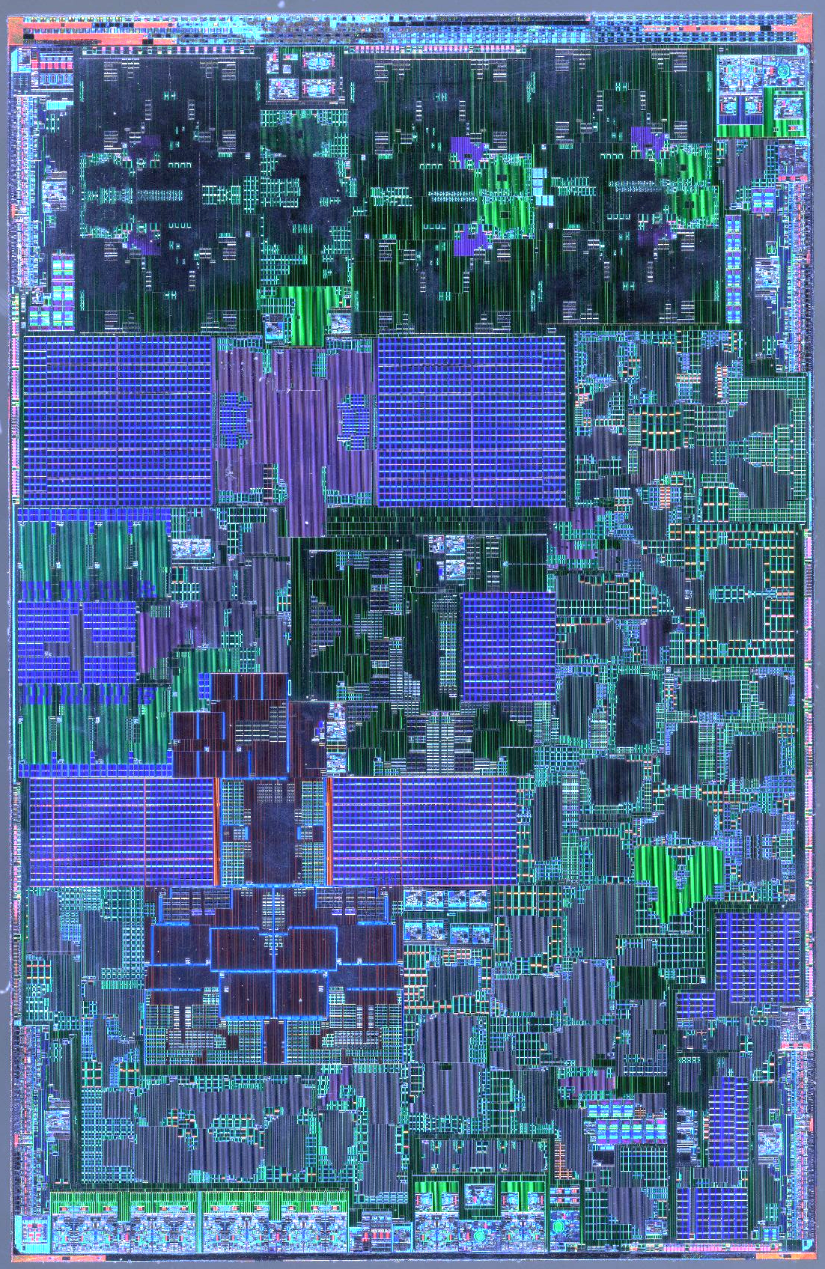
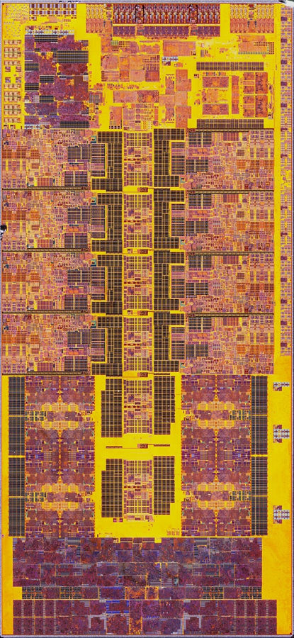
Outline
1.Introduction
2.big.Little Architecture Context (fr. ARM)
3.Completely Fair Scheduler (CFS)
4.Energy Aware Scheduling (EAS)
Apple A17 Pro
Intel i9-13900K
Notes:
https://www.kernel.org/doc/html/latest/translations/zh_CN/scheduler/sched-capacity.html
https://www.kernel.org/doc/html/latest/scheduler/sched-capacity.html
https://lwn.net/htmlArticles/481055/
https://en.wikipedia.org/wiki/Raptor_Lake#/media/File:Intel@intel7(10nmESF)@RaptorLake@RPL(8P+16E)@i9-13900K@ES_DSCx05_poly@5xExt.jpg

Slide 3
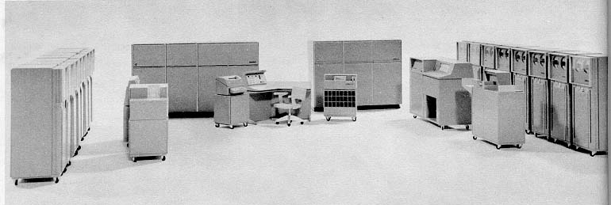
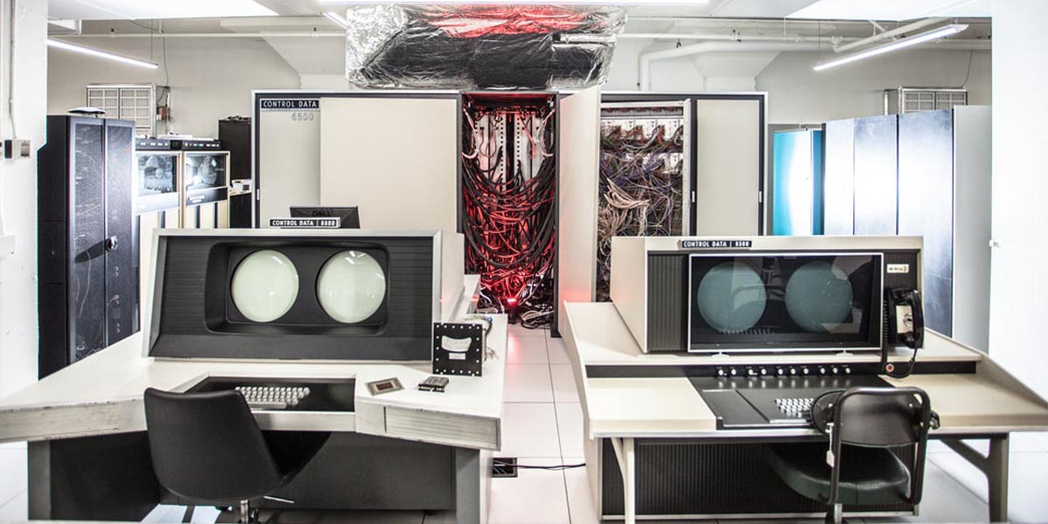
History
Before the advent of Symmetric Multiprocessing (SMP), concept of Asymmetric Multiprocessing (ASMP) emerged in the 1960s and 1970s as a cost-effective method to enhance computing power by adding more CPUs without significant costs.
In recent years, ASMP architecture like big.Little has emerged mainly to solve the contradiction between power consumption and performance.
Burroughs B5000
CDC 6500
https://livingcomputers.org/Computer-Collection/Vintage-Computers/Mainframes/CDC-6500.aspx
Notes:
Burroughs B5000: Introduced the concept of a secondary processor (Processor B) with limited operational capabilities and no peripheral connections.
CDC 6500: User applications ran on central processors while the operating system ran on peripheral processors. OS
https://livingcomputers.org/Computer-Collection/Vintage-Computers/Mainframes/CDC-6500.aspx

Slide 4
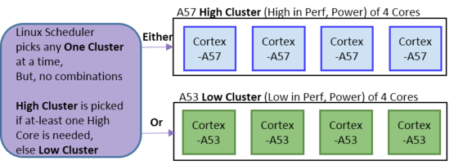
Introduction
What is big.LITTLE?
• Complex multicore CPU architecture combining...
– Several high performance “big” cores
– Several lower power “small” cores
Notes:
What is big.LITTLE?
• Cores should be architecturally compatible
• Cores may be...
– Of 2 different architectures
– Of the same architecture but with different...
• Highest frequency
• Cache size

Slide 5
Introduction
Why big.LITTLE?
• Targeting optimal power saving/performance
balance
– Real life CPU load is bursty
• big.LITTLE allows for running power hungry cores only when bursts are coming
– Peak performance only when it's needed
– Power optimized cores run most of the time
• More options for fine tuning compared to standard
SMP

Slide 6
Context
Big / LITTLE cores: how to combine
• Clustered switching
– A cluster of big cores and a cluster of little ones
– The OS can only use one cluster at a time
– Standard SMP scheduling within the cluster

Slide 7
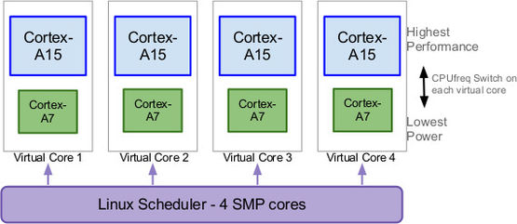
Context
Big / LITTLE cores: how to combine
• In-kernel switching (CPU migration)
– Little and big cores are split into pairs

Slide 8
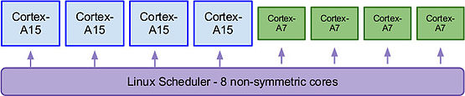
Context
Big / LITTLE cores: how to combine
• Heterogeneous switching (HMP)
– All cores can be used simultaneously

Slide 9
CFS
Mainline Linux scheduler (“fair”)
• Goals of the completely fair scheduler (CFS)
– Even distribution of task load across cores
– The task ready to run should quickly find core to run on
• Implementation
– Sorting tasks in ascending order by CPU bandwidth
received
• Red-black trees are used to streamline the process
• The leftmost task off the tree is picked up next
– It has the least spent execution time
• Limitations
– Implies that the cores are the same (e. g. SMP)

Slide 10
CFS-obstacles
Big (and LITTLE) obstacles
• Mainline CFS is not really applicable to b.L
– Global symmetry principle doesn't work in asymmetrical
system
• Big cores require careful treatment
– Should only be run when it's really needed
• Power consumption and heating issues
– Detection of such situation is the problem to solve
• Task packing problem

Slide 11
Energy Aware Scheduling
Energy-aware scheduling (EAS) gives the scheduler the reference to predict the impact of its decisions on the energy consumed by CPUs. EAS relies on an Energy Model (EM) of the CPUs to select an energy-efficient CPU for each task, with a minimal impact on throughput.
🎯 Goal:
Minimize energy cost while still getting the job done without significantly impacting system throughput and reaching “good enough” performance.
Performance
[instruct/sec]
System
Performance
Selection
(Scheduler)
🔺Maximize:
Performance [inst/s] per Power [W]
= 🔻Minimizing:
Energy [J] per Instruction
Better
P-Core
E-Core 2
E-Core 1
E
P
Power [W]
https://docs.kernel.org/next/scheduler/sched-energy.html
https://www.linaro.org/blog/energy-aware-scheduling-eas-progress-update
Notes:
Energy Aware Scheduling (EAS) progress update | Blog | Linaro
Energy Aware Scheduling — The Linux Kernel documentation
Scheduler — The Linux Kernel documentation

Slide 12
Energy Aware Scheduling
Energy-aware scheduling (EAS) alters the assignment of Completely Fair Scheduler (CFS) tasks to CPUs by utilizing the Energy Model (EM) to make better scheduling decisions.
Energy Model (EM) enables the scheduler to assess the consequences of its decisions by using a much simpler design to minimize the impact on scheduler latency. This model aids in choosing the most energy-efficient CPU for task execution without compromising system performance, using knowledge of CPU capacities and energy costs.
Energy Model (EM)
Performance
[instruct/sec]
E-Core |  | P-Core
Cap | Pwr | Cap | Pwr
170 | 50 | 512 | 400
341 | 150 | 768 | 800
512 | 300 | 1024 | 1700
P-Core
E-Core
Operating Performance Point (OPP)
{
Power [W]
https://docs.kernel.org/next/scheduler/sched-energy.html
https://www.linaro.org/blog/energy-aware-scheduling-eas-progress-update

Slide 13
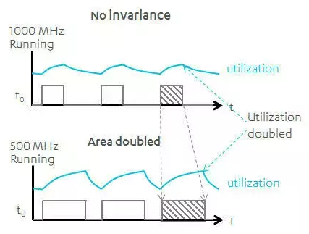
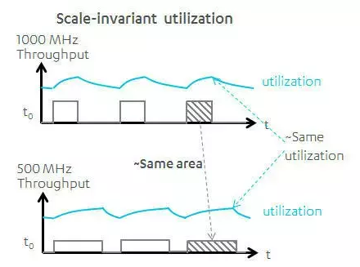
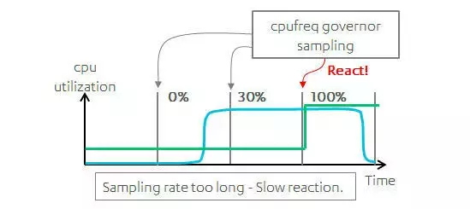
Energy Aware Scheduling
During task wake-up, EAS leverages the EM along with Per-Entity Load Tracking (PELT) signals to select an optimal CPU. The function select_task_rq_fair() invokes find_energy_efficient_cpu(), which identifies the CPU with the highest available capacity in each performance domain. This choice helps maintain lower operational frequencies, therefore saving energy. The decision process evaluates if moving the task to a new CPU will be more energy-efficient compared to its previous CPU.
The compute_energy() function estimates the energy impact of migrating the waking task, simulating the new task distribution across CPUs. The em_pd_energy() API from the EM framework calculates the expected energy consumption for each performance domain based on this simulated distribution.
DVFS (cpufreq)
Disadvantage
PELT
* Only aware of the overall CPU loading, not aware of task migration
https://lkml.org/lkml/2015/8/14/296
Notes:
https://lkml.org/lkml/2015/8/14/296；Energy Aware Scheduling (EAS) progress update | Blog | Linaro（https://www.linaro.org/blog/energy-aware-scheduling-eas-progress-update/）

Slide 14
EAS Example
A (fake) platform with 2 independent performance domains composed of two CPUs each. CPU0 and CPU1 are little CPUs; CPU2 and CPU3 are big.
The scheduler must decide where to place a task P whose util_avg = 200 and prev_cpu = 0.
The current utilization landscape of the CPUs is depicted on the graph below. CPUs 0-3 have a util_avg of 400, 100, 600 and 500 respectively. Each performance domain has three Operating Performance Points (OPPs). The CPU capacity and power cost associated with each OPP is listed in the Energy Model table. The util_avg of P is marked as ‘PP’.
CPU Util.
PP
Waking Task est. Util.
* Try to schedule waking task [ PP ] to each core.
1024
768
Current Util.
512
Other OPP Case
341
170
Current OPP
CPU0
CPU1
CPU2
CPU3
E-Core
P-Core
https://www.linaro.org/blog/energy-aware-scheduling-eas-progress-update/

Slide 15
EAS Example
Schedule to CPU0
Schedule to CPU1
CPU Util.
1024
768
OPP Increased!
512
341
PP
170
PP
CPU0
CPU1
CPU2
CPU3
E-Core
P-Core
OPP Increased!
Energy Model (EM) All OPP Cases
Waking Task est. Util.
E-Core |  | P-Core
Cap | Pwr | Cap | Pwr
170 | – | 512 | –
341 | – | 768 | –
512 | – | 1024 | –
PP
PP
PP
Current Util.
Other OPP Case
Current OPP
Schedule to CPU3
Schedule to CPU2
https://www.linaro.org/blog/energy-aware-scheduling-eas-progress-update/

Slide 16
EAS Example
🏆
Winner \( ﾟヮﾟ)/
Total_energy = SUM(Energy(CPUn))
Energy(CPU) = Util. / Cap. * Pwr. * k
total_energy = 1437
total_energy = 1364
* k - allocation perference parameter
OPP Increased!
Energy(CPU0) = 400 / 512 * 300 = 234
Energy(CPU1) = 100 / 512 * 300 = 58
Energy(CPU2) = 600 / 768 * 800 = 625
Energy(CPU3) = 500 / 768 * 800 = 520
Total_energy = 1437
PP
PP
OPP Increased!
Energy(CPU0) = 200 / 341 * 150 = 88
Energy(CPU1) = 100 / 341 * 150 = 43
Energy(CPU2) = 600 / 768 * 800 = 625
Energy(CPU3) = 700 / 768 * 800 = 729
Total_energy = 1485
PP
PP
total_energy = 1485
total_energy = 2129
https://www.linaro.org/blog/energy-aware-scheduling-eas-progress-update/

Slide 17
Other Scheduling Reference
x86-64 & IA32:
Intel Thread Director (ITD) + Hardware Feedback Interface (HFI) (Windows)
64-bit ARM:
Cluster-Aware Scheduling (Linux 5.16+ for Kunpeng SoCs)
https://kernel.org/doc/html/v5.18/x86/intel-hfi.html
https://www.phoronix.com/review/alderlake-p-e
Notes:
Intel i9-12900K Alder Lake Linux Performance In Different P/E Core Configurations - Phoronix
14. Hardware-Feedback Interface for scheduling on Intel Hardware — The Linux Kernel documentation
Intel Hardware Feedback Interface "HFI" Driver Submitted For Linux 5.18 - Phoronix
Intel Alder Lake's Thread Director Support Coming to Linux | Tom's Hardware (tomshardware.com)
Cluster-Aware Scheduling Lands In Linux 5.16 - Phoronix

Slide 18
Thank you!

